Slide 1


Welcome you all
JAVA PROGRAMMING
DAY : 3
D.Sakthivel
Assistant Professor & Trainer,
KGiSL Micro College
KGiSL Campus, Coimbatore – 641 035.

Slide 2
Day 3
Object-Oriented Programming Concepts
Object
Class
Inheritance
Polymorphism
Abstraction
Encapsulation
Java Naming Convention
Object and Class
Method in Java
Instance Method
Abstract Method

Slide 3
Object-Oriented Programming
Object-Oriented Programming is a paradigm that provides many concepts, such as inheritance, data binding, polymorphism, etc.
Simula is considered the first object-oriented programming language.
The programming paradigm where everything is represented as an object is known as a truly object-oriented programming language.
Smalltalk is considered the first truly object-oriented programming language.
The popular object-oriented languages are Java, C#, PHP, Python, C++, etc.
The main aim of object-oriented programming is to implement real-world entities,
for example, object, classes, abstraction, inheritance, polymorphism, etc.

Slide 4
OOPs (Object-Oriented Programming System)
Object means a real-world entity such as a pen, chair, table, computer, watch, etc.
Object-Oriented Programming is a methodology or paradigm to design a program using classes and objects.
It simplifies software development and maintenance by providing some concepts:
Object
Class
Inheritance
Polymorphism
Abstraction
Encapsulation

Slide 5
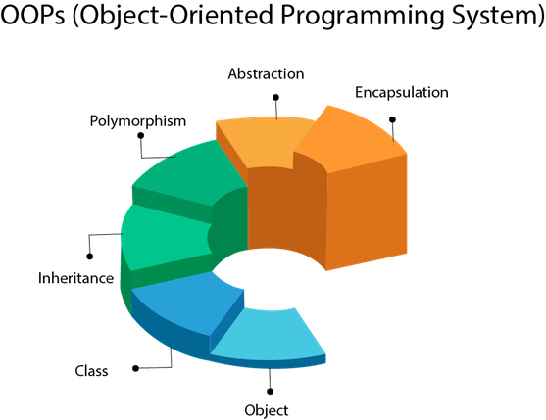
OOPs (Object-Oriented Programming System)

Slide 6
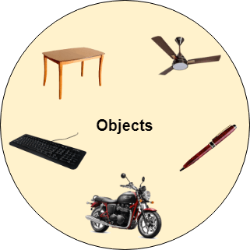
Object
Any entity that has state and behavior is known as an object.
For example, a chair, pen, table, keyboard, bike, etc. It can be physical or logical.
An Object can be defined as an instance of a class.
An object contains an address and takes up some space in memory.
Objects can communicate without knowing the details of each other's data or code.
The only necessary thing is the type of message accepted and the type of response returned by the objects.
Example: A dog is an object because it has states like color, name, breed, etc. as well as behaviors like wagging the tail, barking, eating, etc.

Slide 7
Class
Collection of objects is called class. It is a logical entity.
A class can also be defined as a blueprint from which you can create an individual object. Class doesn't consume any space.
Classes can be described as blueprints, descriptions, or definitions for an object.
You can use the same class as a blueprint for creating multiple objects.
The first step is to define the class, which then becomes a blueprint for object creation.
Each class has a name, and each is used to define attributes and behavior.

Slide 8
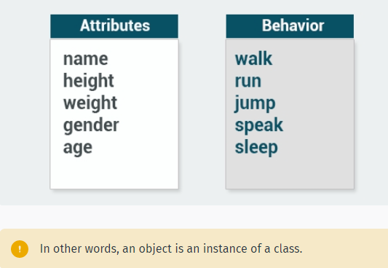
Class

Slide 9

Encapsulation
Binding (or wrapping) code and data together into a single unit are known as encapsulation.
For example, a capsule, it is wrapped with different medicines.
A java class is the example of encapsulation.
Java bean is the fully encapsulated class because all the data members are private here.

Slide 10
Abstraction
Hiding internal details and showing functionality is known as abstraction.
For example phone call, we don't know the internal processing.
In Java, we use abstract class and interface to achieve abstraction.

Slide 11
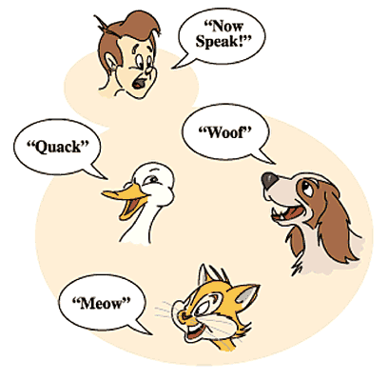
Polymorphism
If one task is performed in different ways, it is known as polymorphism.
For example: to convince the customer differently, to draw something, for example, shape, triangle, rectangle, etc.
In Java, we use method overloading and method overriding to achieve polymorphism.
Another example can be to speak something; for example, a cat speaks meow, dog barks woof, etc.

Slide 12
Inheritance
When one object acquires all the properties and behaviors of a parent object, it is known as inheritance.
It provides code reusability. It is used to achieve runtime polymorphism.

Slide 13
Java Naming Convention
Java naming convention is a rule to follow as you decide what to name your identifiers such as class, package, variable, constant, method, etc.
By using standard Java naming conventions, you make your code easier to read for yourself and other programmers.
Identifiers Type | Naming Rules | Examples
Class | It should start with the uppercase letter. It should be a noun such as Color, Button, System, Thread, etc. Use appropriate words, instead of acronyms. | public class Employee { //code snippet }
Interface | It should start with the uppercase letter. It should be an adjective such as Runnable, Remote, ActionListener. Use appropriate words, instead of acronyms. | interface Printable { //code snippet }

Slide 14
Java Naming Convention
Method | It should start with lowercase letter. It should be a verb such as main(), print(), println(). If the name contains multiple words, start it with a lowercase letter followed by an uppercase letter such as actionPerformed(). | class Employee { // method void draw() { //code snippet } }
Variable | It should start with a lowercase letter such as id, name. It should not start with the special characters like & (ampersand), $ (dollar), _ (underscore). If the name contains multiple words, start it with the lowercase letter followed by an uppercase letter such as firstName, lastName. Avoid using one-character variables such as x, y, z. | class Employee { // variable int id; //code snippet }

Slide 15
Java Naming Convention
Package | It should be a lowercase letter such as java, lang. If the name contains multiple words, it should be separated by dots (.) such as java.util, java.lang. | //package package com.javatpoint; class Employee { //code snippet }
Constant | It should be in uppercase letters such as RED, YELLOW. If the name contains multiple words, it should be separated by an underscore(_) such as MAX_PRIORITY. It may contain digits but not as the first letter. | class Employee { //constant static final int MIN_AGE = 18; //code snippet }

Slide 16
Java Naming Convention
CamelCase in Java naming conventions
Java follows camel-case syntax for naming the class, interface, method, and variable.
If the name is combined with two words, the second word will start with uppercase letter always such as actionPerformed(), firstName, ActionEvent, ActionListener, etc.

Slide 17
Object and Class

Slide 18

What is object?
An entity that has state and behavior is known as an object e.g., chair, bike, marker, pen, table, car, etc.
It can be physical or logical (tangible and intangible).
The example of an intangible object is the banking system.
An object has three characteristics:
State: represents the data (value) of an object.
Behavior: represents the behavior (functionality) of an object such as deposit, withdraw, etc.
Identity: An object identity is typically implemented via a unique ID. The value of the ID is not visible to the external user. However, it is used internally by the JVM to identify each object uniquely.

Slide 19
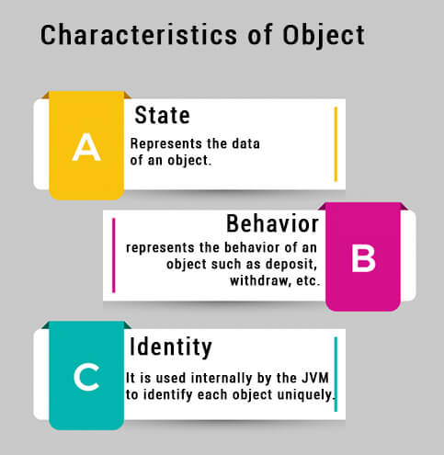
What is object?
For Example, Pen is an object. Its name is Reynolds; color is white, known as its state.
It is used to write, so writing is its behavior.
An object is an instance of a class. A class is a template or blueprint from which objects are created. So, an object is the instance(result) of a class.
Object Definitions:
An object is a real-world entity.
An object is a runtime entity.
The object is an entity which has state and behavior.
The object is an instance of a class.

Slide 20
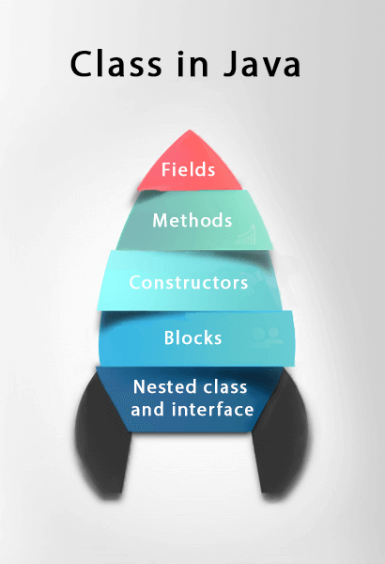
What is class?
A class is a group of objects which have common properties.
It is a template or blueprint from which objects are created.
It is a logical entity. It can't be physical.
A class in Java can contain:
Fields
Methods
Constructors
Blocks
Nested class and interface

Slide 21
What is class?
Syntax to declare a class:
class <class_name>{
field;
method;
}
Instance variable in Java
A variable which is created inside the class but outside the method is known as an instance variable.
Instance variable doesn't get memory at compile time.
It gets memory at runtime when an object or instance is created.
That is why it is known as an instance variable.

Slide 22
Method in Java
In Java, a method is like a function which is used to expose the behavior of an object.
Advantage of Method
Code Reusability
Code Optimization
new keyword in Java
The new keyword is used to allocate memory at runtime. All objects get memory in Heap memory area.
Example Program (Object1 & Object2)
Object and Class Example: main within the class – Object 1 program
Object and Class Example: main outside the class – Object2 program

Slide 23
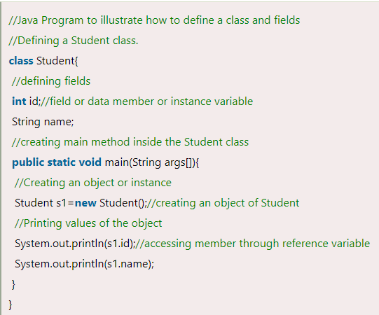
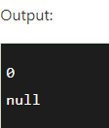
Example Program :
Object and Class Example: main within the class

Slide 24
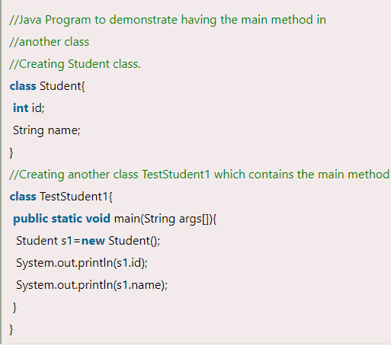
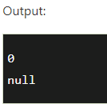
Example Program :
Object and Class Example: main outside the class

Slide 25
3 Ways to initialize object
There are 3 ways to initialize object in Java.
By reference variable
By method
By constructor
1) Object and Class Example: Initialization through reference
Initializing an object means storing data into the object.
Let's see a simple example where we are going to initialize the object through a reference variable.

Slide 26
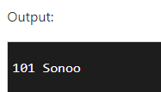
Initialization through reference
class Student{
int id;
String name;
}
class TestStudent2{
public static void main(String args[]){
Student s1=new Student();
s1.id=101;
s1.name="Sonoo";
System.out.println(s1.id+" "+s1.name); //printing members with a white space
}
}

Slide 27
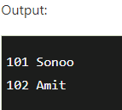
We can also create multiple objects and store information in it through reference variable.
class Student{
int id;
String name;
}
class TestStudent3{
public static void main(String args[]){
//Creating objects
Student s1=new Student();
Student s2=new Student();
//Initializing objects
s1.id=101;
s1.name="Sonoo";
s2.id=102;
s2.name="Amit";
//Printing data
System.out.println(s1.id+" "+s1.name);
System.out.println(s2.id+" "+s2.name);
}
}

Slide 28
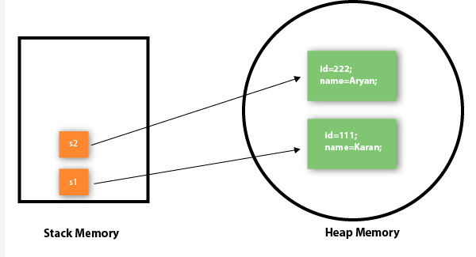
Object and Class Example: Initialization through method
In this example, we are creating the two objects of Student class and initializing the value to these objects by invoking the insertRecord method.
Here, we are displaying the state (data) of the objects by invoking the displayInformation() method.
As you can see in the above figure, object gets the memory in heap memory area. The reference variable refers to the object allocated in the heap memory area. Here, s1 and s2 both are reference variables that refer to the objects allocated in memory.

Slide 29
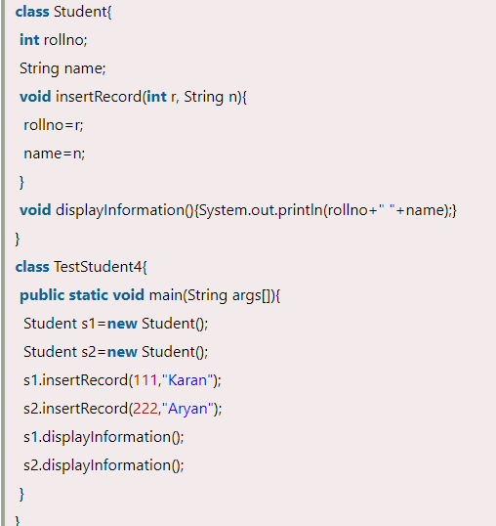
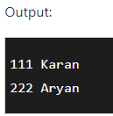
Object and Class Example: Initialization through method

Slide 30
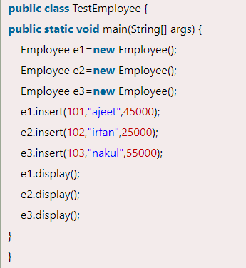
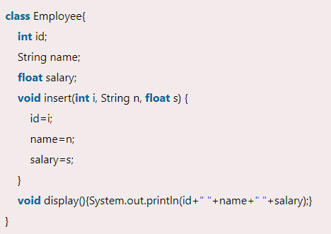
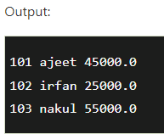
Object and Class Example: Initialization through a constructor

Slide 31
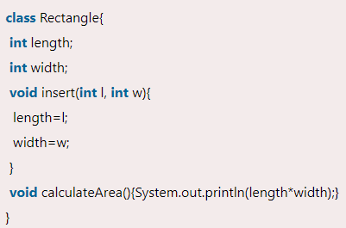
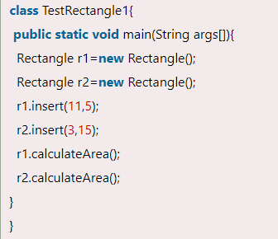
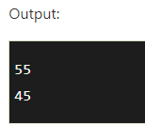
Object and Class Example: Rectangle

Slide 32
What are the different ways to create an object in Java?
There are many ways to create an object in java. They are:
By new keyword
By newInstance() method
By clone() method
By deserialization
By factory method etc.

Slide 33
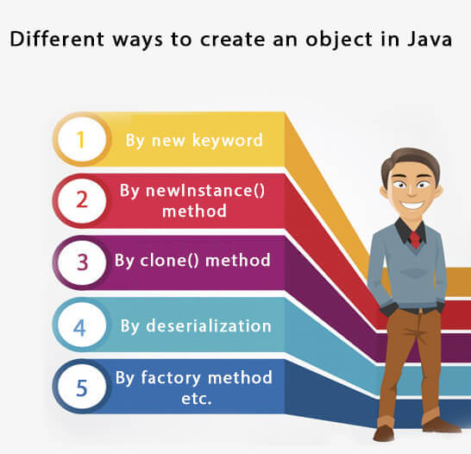

Slide 34
Anonymous object
Anonymous simply means nameless. An object which has no reference is known as an anonymous object. It can be used at the time of object creation only.
If you have to use an object only once, an anonymous object is a good approach. For example:
new Calculation();//anonymous object
Calling method through a reference:
Calculation c=new Calculation();
c.fact(5);
Calling method through an anonymous object
new Calculation().fact(5);

Slide 35
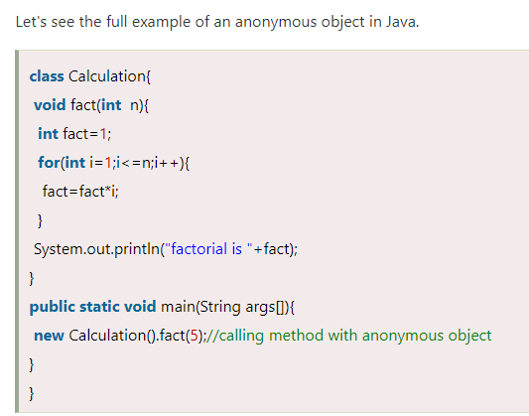
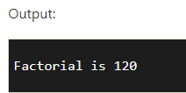

Slide 36
Creating multiple objects by one type only
We can create multiple objects by one type only as we do in case of primitives.
Initialization of primitive variables:
int a=10, b=20;
Initialization of reference variables:
Rectangle r1=new Rectangle(), r2=new Rectangle();//creating two objects

Slide 37
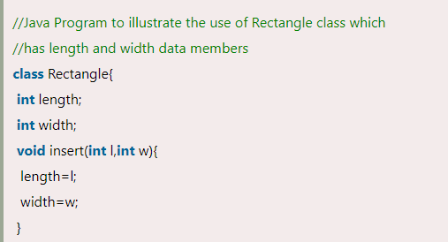
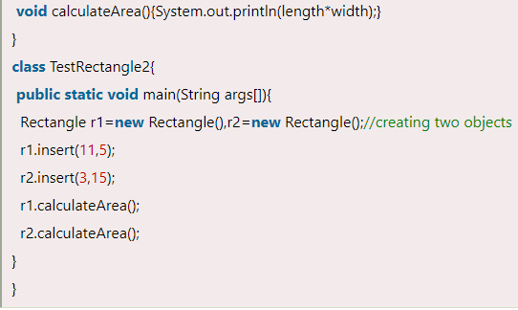
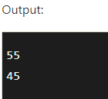

Slide 38
Method in Java

Slide 39
Method in Java
In general, a method is a way to perform some task.
Similarly, the method in Java is a collection of instructions that performs a specific task.
It provides the reusability of code. We can also easily modify code using methods.
What is a method in Java?
A method is a block of code or collection of statements or a set of code grouped together to perform a certain task or operation.
It is used to achieve the reusability of code. We write a method once and use it many times.
We do not require to write code again and again. It also provides the easy modification and readability of code, just by adding or removing a chunk of code.
The method is executed only when we call or invoke it.
The most important method in Java is the main() method.

Slide 40
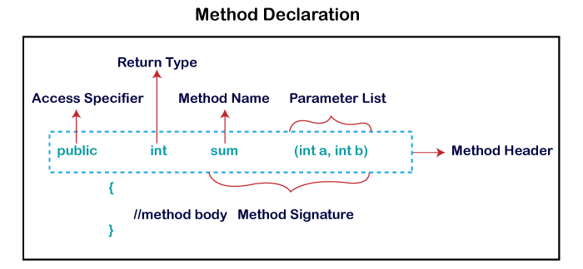
Method Declaration
The method declaration provides information about method attributes, such as visibility, return-type, name, and arguments.
It has six components that are known as method header, as we have shown in the following figure.

Slide 41
Method Signature: Every method has a method signature. It is a part of the method declaration. It includes the method name and parameter list.
Access Specifier: Access specifier or modifier is the access type of the method. It specifies the visibility of the method. Java provides four types of access specifier:
Public: The method is accessible by all classes when we use public specifier in our application.
Private: When we use a private access specifier, the method is accessible only in the classes in which it is defined.
Protected: When we use protected access specifier, the method is accessible within the same package or subclasses in a different package.
Default: When we do not use any access specifier in the method declaration, Java uses default access specifier by default. It is visible only from the same package only.

Slide 42
Return Type: Return type is a data type that the method returns. It may have a primitive data type, object, collection, void, etc. If the method does not return anything, we use void keyword.
Method Name: It is a unique name that is used to define the name of a method. It must be corresponding to the functionality of the method. Suppose, if we are creating a method for subtraction of two numbers, the method name must be subtraction(). A method is invoked by its name.
Parameter List: It is the list of parameters separated by a comma and enclosed in the pair of parentheses. It contains the data type and variable name. If the method has no parameter, left the parentheses blank.
Method Body: It is a part of the method declaration. It contains all the actions to be performed. It is enclosed within the pair of curly braces.

Slide 43
Naming a Method
While defining a method, remember that the method name must be a verb and start with a lowercase letter.
If the method name has more than two words, the first name must be a verb followed by adjective or noun.
In the multi-word method name, the first letter of each word must be in uppercase except the first word.
For example:
Single-word method name: sum(), area()
Multi-word method name: areaOfCircle(), stringComparision()

Slide 44
Types of Method
There are two types of methods in Java:
Predefined Method
User-defined Method
Predefined Method
In Java, predefined methods are the method that is already defined in the Java class libraries is known as predefined methods.
It is also known as the standard library method or built-in method.
We can directly use these methods just by calling them in the program at any point. Some pre-defined methods are length(), equals(), compareTo(), sqrt(), etc.

Slide 45
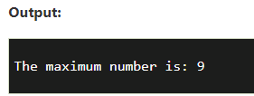
Predefined Method
Each and every predefined method is defined inside a class.
Such as print() method is defined in the java.io.PrintStream class.
It prints the statement that we write inside the method.
For example, print("Java"), it prints Java on the console.
public class Demo
{
public static void main(String[] args)
{
// using the max() method of Math class
System.out.print("The maximum number is: " + Math.max(9,7));
}
}

Slide 46
User-defined Method
The method written by the user or programmer is known as a user-defined method.
These methods are modified according to the requirement.
How to Create a User-defined Method
//user defined method
public static void findEvenOdd(int num)
{
//method body
if(num%2==0)
System.out.println(num+" is even");
else
System.out.println(num+" is odd");
}

Slide 47
How to Call or Invoke a User-defined Method
import java.util.Scanner;
public class EvenOdd
{
public static void main (String args[])
{
//creating Scanner class object
Scanner scan=new Scanner(System.in);
System.out.print("Enter the number: ");
//reading value from the user
int num=scan.nextInt();
//method calling
findEvenOdd(num);
}

Slide 48
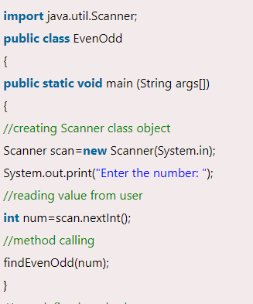
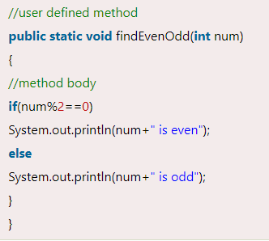

Let's combine both snippets of codes in a single program and execute it.

Slide 49
Static Method
A method that has static keyword is known as static method.
In other words, a method that belongs to a class rather than an instance of a class is known as a static method.
We can also create a static method by using the keyword static before the method name.
The main advantage of a static method is that we can call it without creating an object.
It can access static data members and also change the value of it.
It is used to create an instance method.
It is invoked by using the class name. The best example of a static method is the main() method.

Slide 50

public class Display
{
public static void main(String[] args)
{
show();
}
static void show()
{
System.out.println("It is an example of static method.");
}
}

Slide 51
Instance Method
The method of the class is known as an instance method.
It is a non-static method defined in the class.
Before calling or invoking the instance method, it is necessary to create an object of its class.
Let's see an example of an instance method.

Slide 52
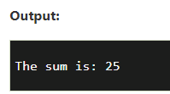
public class InstanceMethodExample
{
public static void main(String [] args)
{
//Creating an object of the class
InstanceMethodExample obj = new InstanceMethodExample();
//invoking instance method
System.out.println("The sum is: "+obj.add(12, 13));
}
int s;
//user-defined method because we have not used static keyword
public int add(int a, int b)
{
s = a+b;
//returning the sum
return s;
}
}

Slide 53
There are two types of instance method:
Accessor Method
Mutator Method
Accessor Method:
The method(s) that reads the instance variable(s) is known as the accessor method.
We can easily identify it because the method is prefixed with the word get.
It is also known as getters. It returns the value of the private field. It is used to get the value of the private field.
Example
public int getId()
{
return Id;
}

Slide 54
Mutator Method:
The method(s) read the instance variable(s) and also modify the values.
We can easily identify it because the method is prefixed with the word set.
It is also known as setters or modifiers. It does not return anything.
It accepts a parameter of the same data type that depends on the field.
It is used to set the value of the private field.
public void setRoll(int roll)
{
this.roll = roll;
}

Slide 55
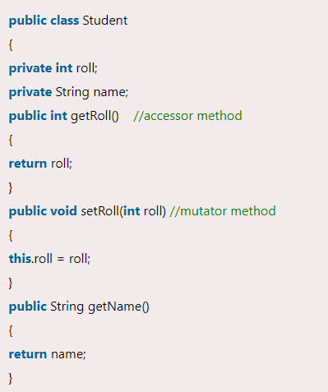
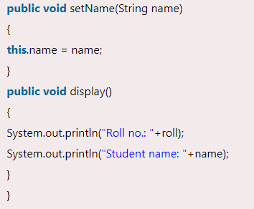

Slide 56
Abstract Method
The method that does not has method body is known as abstract method.
In other words, without an implementation is known as abstract method.
It always declares in the abstract class.
It means the class itself must be abstract if it has abstract method.
To create an abstract method, we use the keyword abstract.
Syntax
abstract void method_name();

Slide 57
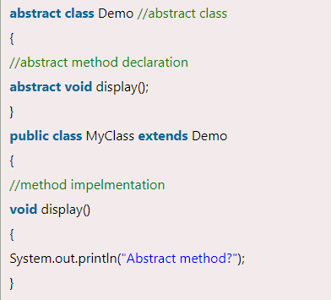
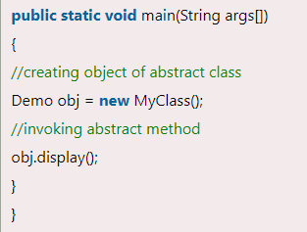
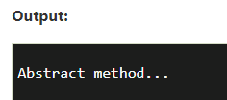
Abstract Method

Slide 58



Thank You

